Slide 1
Preparing to migrate to Cloud

Slide 2
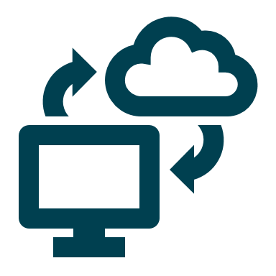
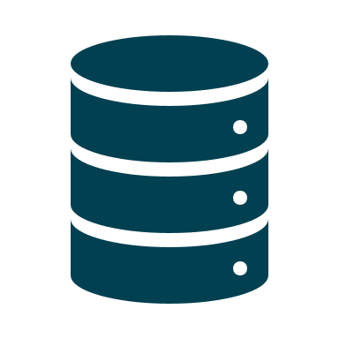


amazon RDS
scenario
on premise server
Notes:
the superstore database that we created during the last few days will be migrated to the amazon cloud – an RDS (manage relational database service) instance
as we go through the preparation steps we will discuss the options that we must consider before settling on our strategy
our primary tool will be the AWS console, through which we will access RDS and quicksight. we will also use SSMS to back up the local database and restore it to the RDS instance
this is the official way to do it natively but our method works well for people who are new to the cloud but have got to know SSMS and SQL already Migrating an on-premises database to Amazon RDS Custom for SQL Server - Amazon Relational Database Service

Slide 3
in order to migrate on premise databases to the cloud we must prepare the following
disconnect live applications
backup database
create target server (RDS)
decide how target server will see backup file (network)
configure roles in AWS
Control point for AWS :
AWS Console or AWS CLI
Overview
Notes:
obviously in this particular case we do not have any live applications to worry about – why is that important ? discuss
in a normal (non test/dev/poc/classroom) scenario you would not be responsible for creating those network bridges between the cloud and local machine / or cloud to cloud – this would be taken care of by the IT team / architects and engineers

Slide 4
database backup

Slide 5


options : create copy of a database

Slide 6
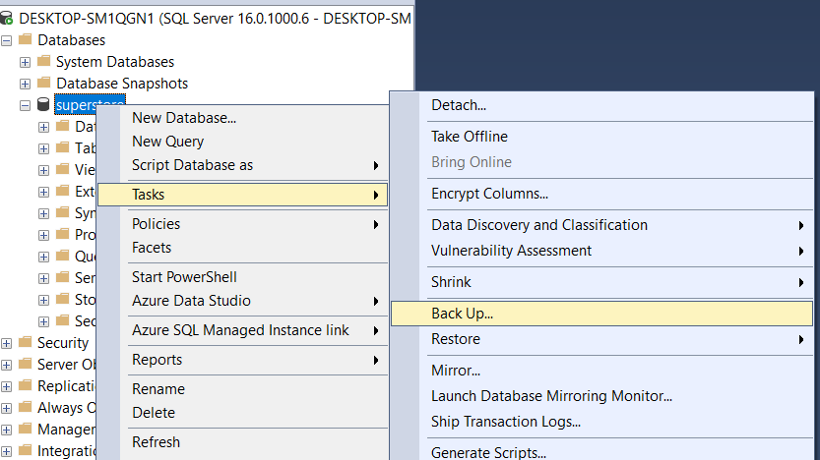
database .bak file

Slide 7
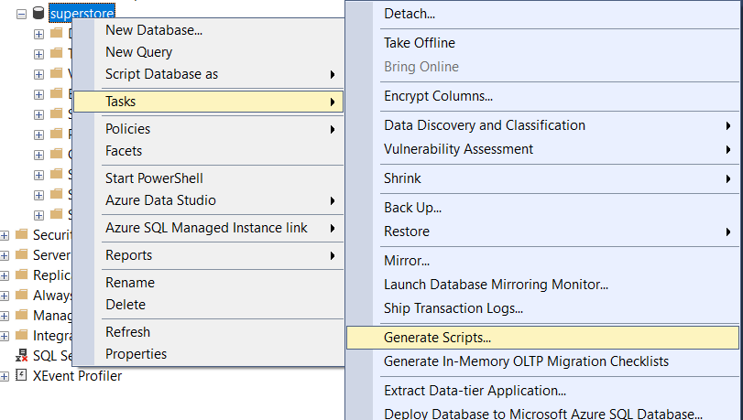
generate script

Slide 8
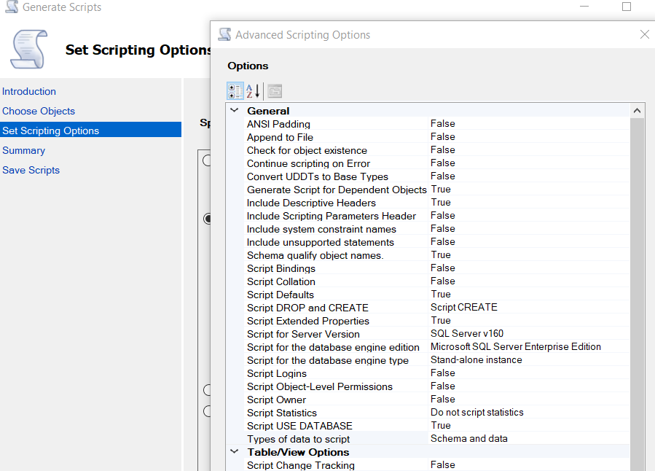
generate script (2)

Slide 9
create target server

Slide 10
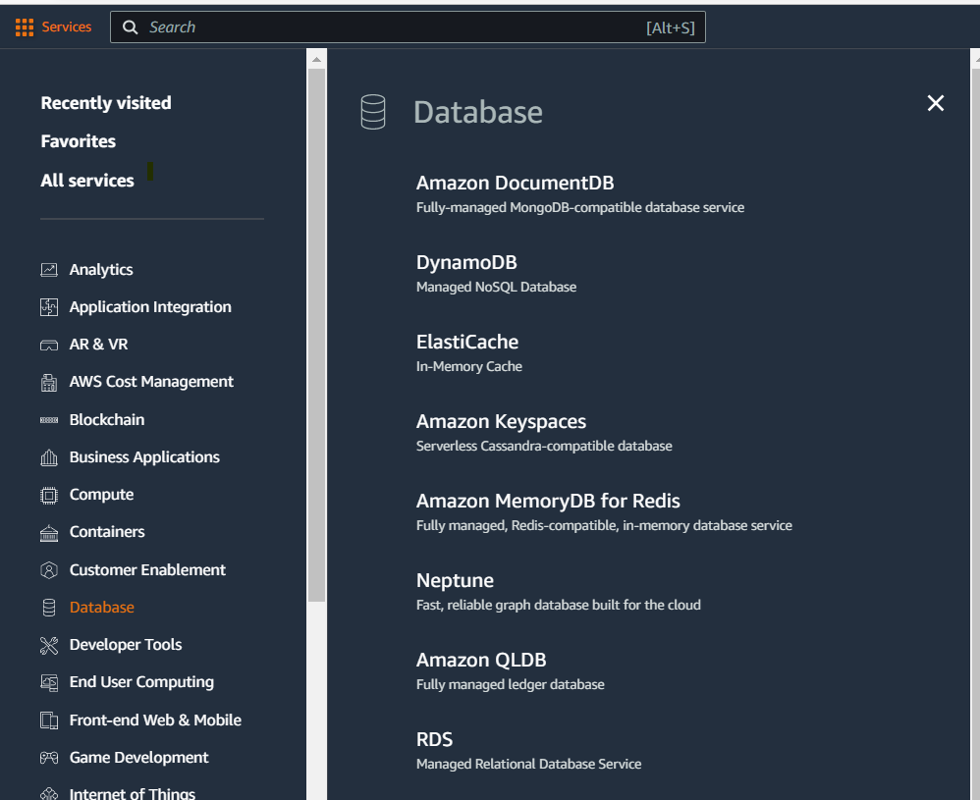
go to rds services

Slide 11
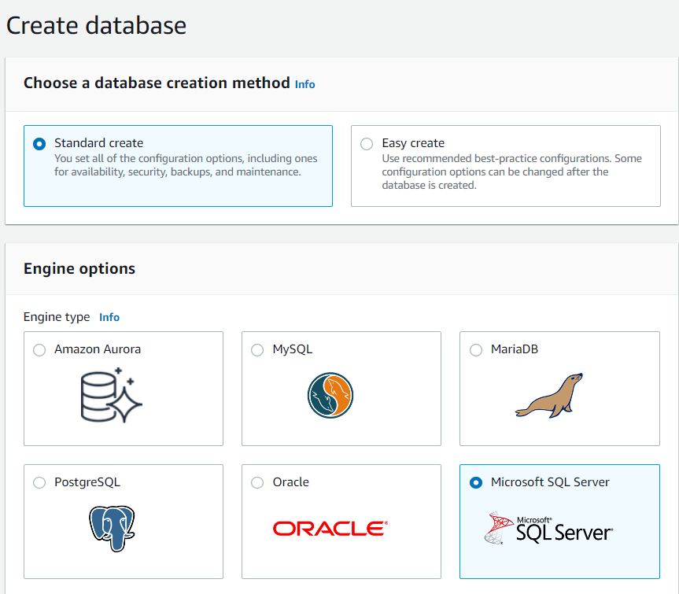
create sql server instance

Slide 12

note the password!

Slide 13
access to the backup

Slide 14




options : retrieve file from where?
aws
stored
proc
SSMS
your laptop
s3
Notes:
could also use mysql workbench to connect to the server
underline that when you work in a cloud env you don’t have access to local file storage as you do when you are RDP or working on prem

Slide 15
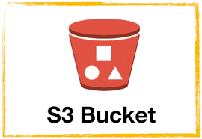
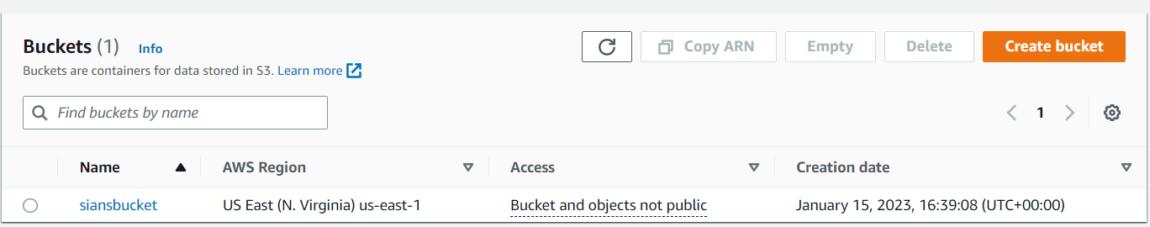
create s3 bucket

Slide 16
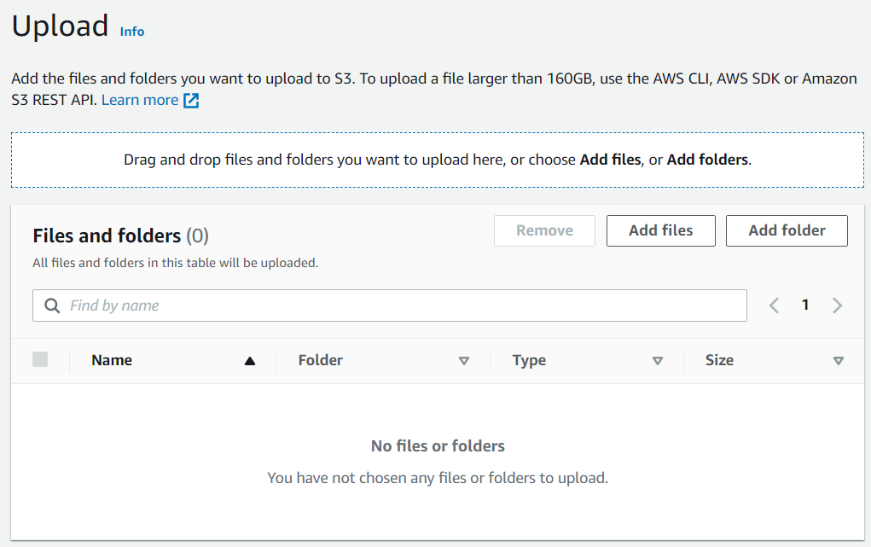
upload file to s3

Slide 17
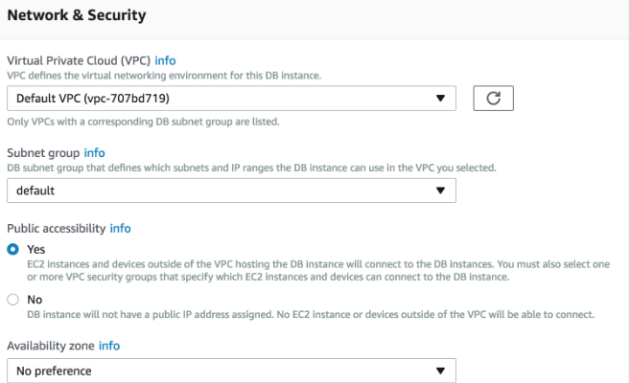
RDS public accessibility
Notes:
if using ssms (familiar client) locally we need to be able to access the server from our laptops – similar to the way we accessed our local SQL instance

Slide 18
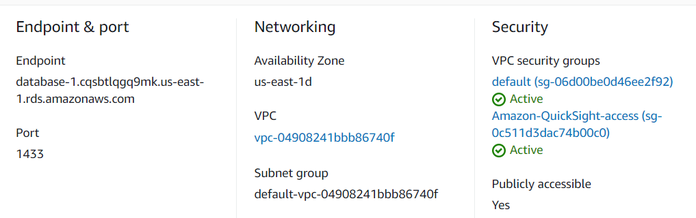
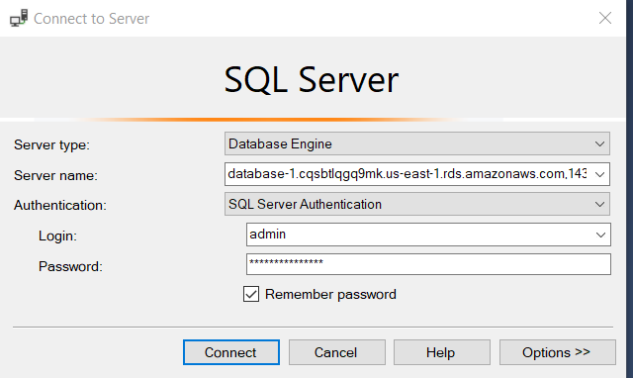
SSMS to RDS
Notes:
from SSMS we need to enter the connectivity details found on the RDS instance info page
test the connectivity works by connecting to the server and running a basic select query on the system database

Slide 19
amazon RDS
scenario
on premise server
Notes:
now we will continue with our scenario by restoring the database to the RDS instance and configuring to allow quicksight to access RDS to create our dashboard in the cloud

Slide 20
Now we will deploy our SQL database to the Cloud and connect to the database for visualisation
restore the database
create a role for quicksight to access RDS
connect to data to test
Overview
Notes:
talk through the final steps of the scenario. instructor will demo and learners will be left to work on the scenario as well as watching the cloud academy labs

Slide 21
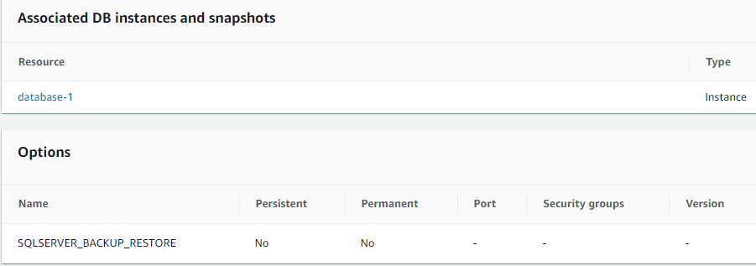
configure option group
This allows native SQL backup restore option – not needed for a create approach
Notes:
this sec group role must be created and then assigned to the db instance if using backup on s3 (.bak) to restore to rds sql server
this allows the admin account (you) to create the db
Working with option groups - Amazon Relational Database Service
Support for native backup and restore in SQL Server - Amazon Relational Database Service
Migrating an on-premises database to Amazon RDS Custom for SQL Server - Amazon Relational Database Service
all steps are in the instructors notes

Slide 22
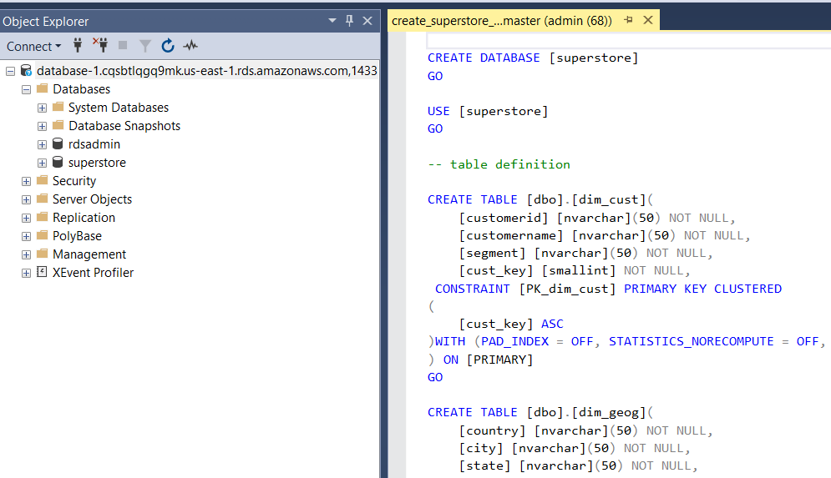
run query to create db
Notes:
in SSMS connect to RDS sql server
open query
check and run query.
version of sql must match from local to cloud servers. troubleshooting of querymay be needed.
tip : remove references to any local files which are not relevant from query and just create tables, populate tables, create stored proc and set read write privelige on db
sample query is provided for instructors and shared with learners
all steps are in the instructors notes

Slide 23
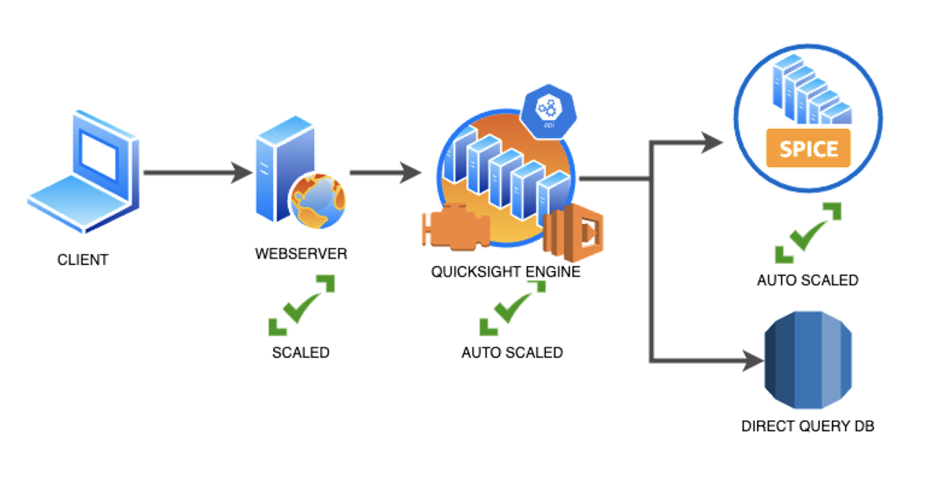
quicksight
cloud data analysis

Slide 24

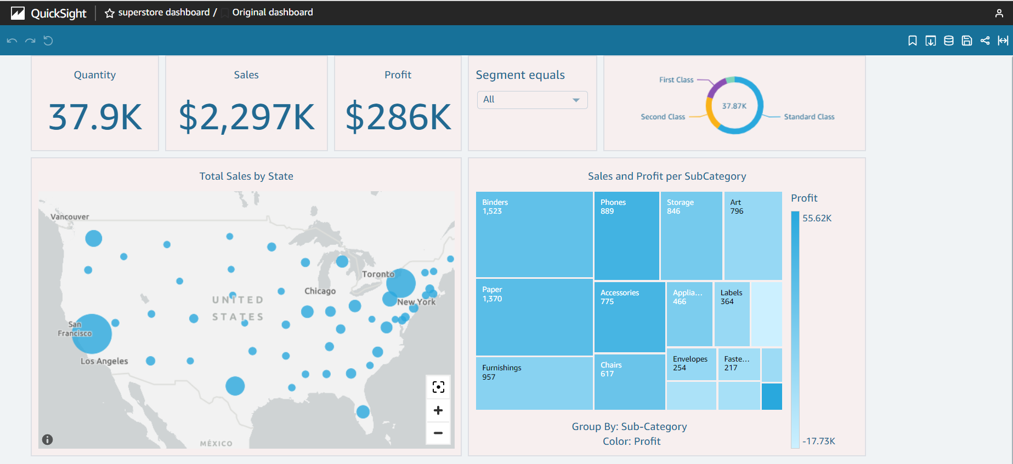


data
analysis
dashboard
share
Notes:
walk through basics of quicksight from a csv
create analysis eg bar chart for customers and deploy as dashboard before sharing as link
https://eu-central-1.quicksight.aws.amazon.com/sn/dashboards/089f938e-6eb7-4c3b-80f1-0ea5b8825e74/views/aeb33053-2e12-496b-a448-fe84df13b547
or create users and groups/ invite
all steps are in the instructors notes

Slide 25
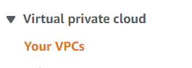
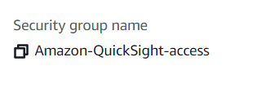
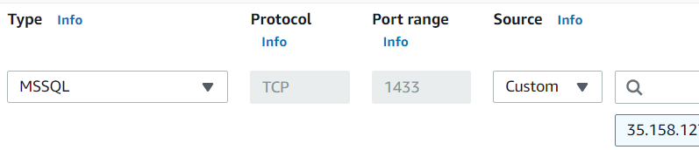
configure inbound connection
Notes:
Manually enabling access to an Amazon RDS instance in a VPC - Amazon QuickSight
create the network ‘bridge’ at the VPC level. a VPC is your virtual private cloud and all of the services in the cloud can theoretically talk to eachother but those contact points have to be enabled. in this case quicksight requires and inbound connection to rds to access the database, write a query and populate the analysis / dashboard.
inbound connections are geographically specific – so if quicksight is being hosted from multiple geog zones multiple inbound allowances are made
AWS Regions, websites, IP address ranges, and endpoints - Amazon QuickSight
use this page to collect the IP for the region quicksight is hosted in
then set up the rule with type MSSQL, and the port as shown.
all steps are in the instructors notes

Slide 26
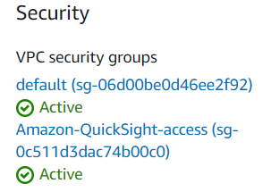
configure inbound connection (2)
Notes:
next this security group should be associated to the DB instance on RDS – completing the circle
all steps are in the instructors notes

